Slide 1
Simple Linear Regression and Correlation
Chapter 11

Slide 2

For Linear regression: y=a+bx
$$b=\frac{n\sum{xy }−\sum{x}\sum{y}}{n\sum{x^{2}−}{(\sum{x})}^{2}}=\frac{\sum{(x−\overline{x})(y−\overline{y})}}{\sum{{(x−\overline{x})}^{2}}}$$
$$a=\overline{y}−b\overline{x}$$

Slide 3
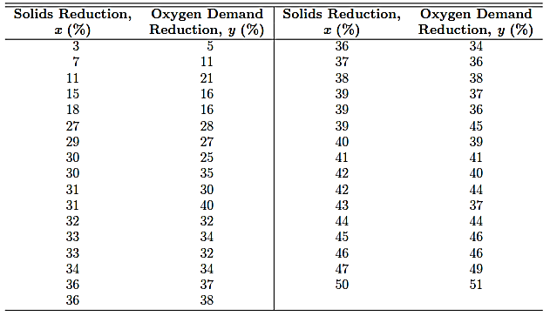
Example 11.1: Estimate the regression line for the 33 samples of chemically treated waste data given in the following table

Slide 4
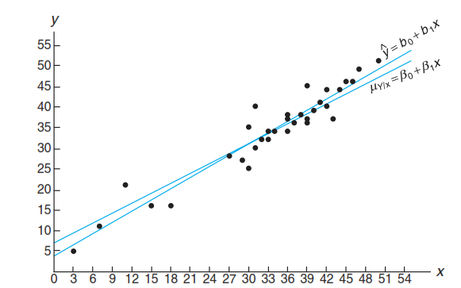

Slide 5
EX 11.2-11.6

Slide 6
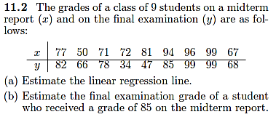

Slide 7


Square error
Sum of square error (SSE)
Sum of square total (SST)

Slide 8

Coefficient of determination
0 ≤ R² ≤ 1

Slide 9
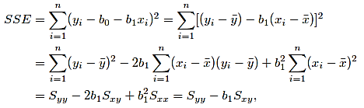

Slide 10
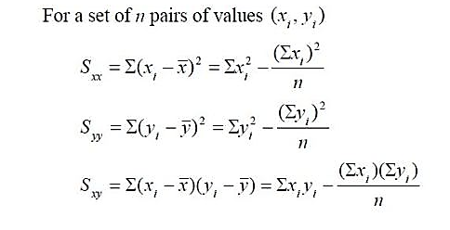

Slide 11
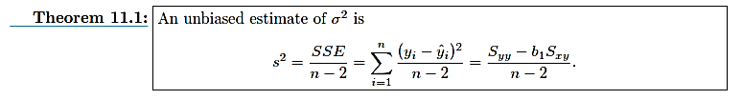

Slide 12
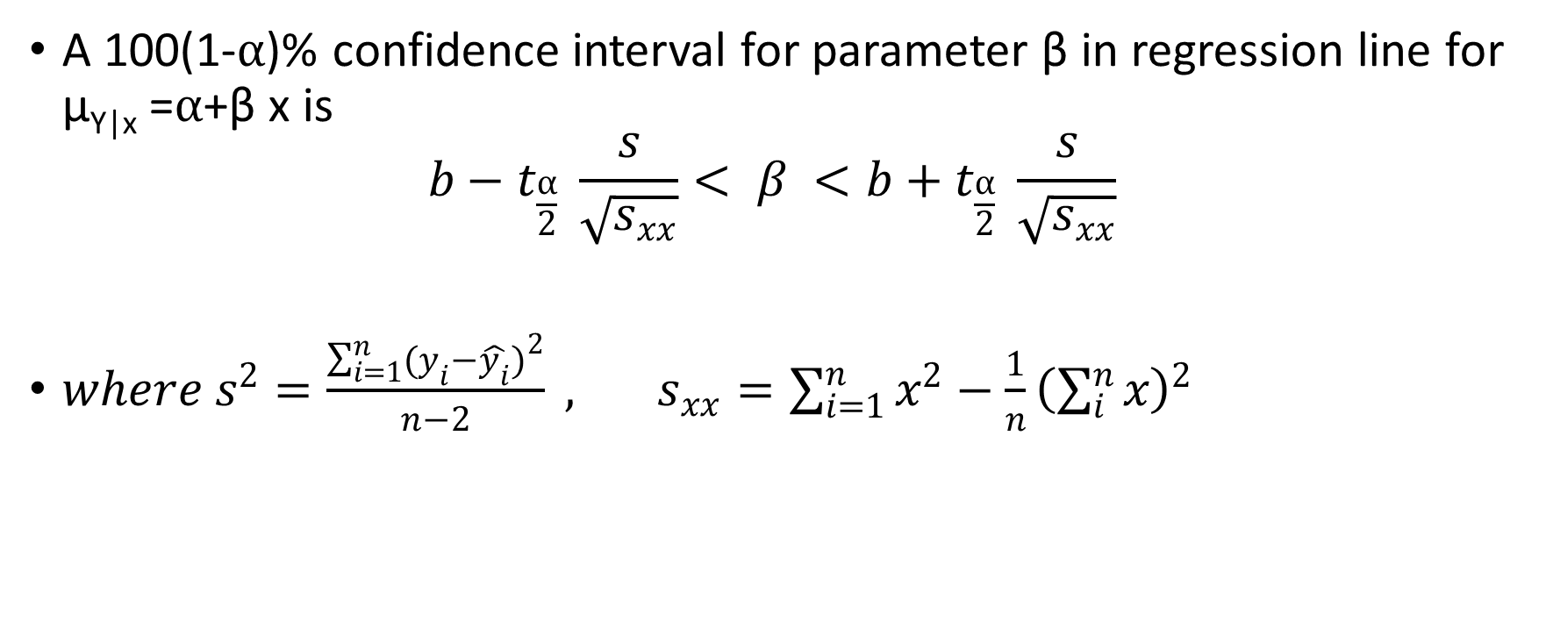
A 100(1-⍺)% confidence interval for parameter β in regression line for μ_{Y|x} =⍺+β x is
$$b−t_{\frac{⍺}{2}} \frac{s}{\sqrt{s_{xx}}}< β <b+t_{\frac{⍺}{2}} \frac{s}{\sqrt{s_{xx}}}$$
$where s^{2}=\frac{\sum_{i=1}^{n}{{(y_{i}−\hat{y_{i}})}^{2}}}{n−2} , s_{xx}=\sum_{i=1}^{n}{x^{2}}−\frac{1}{n}{\left(\sum_{i}^{n}{x}\right)}^{2}$

Slide 13
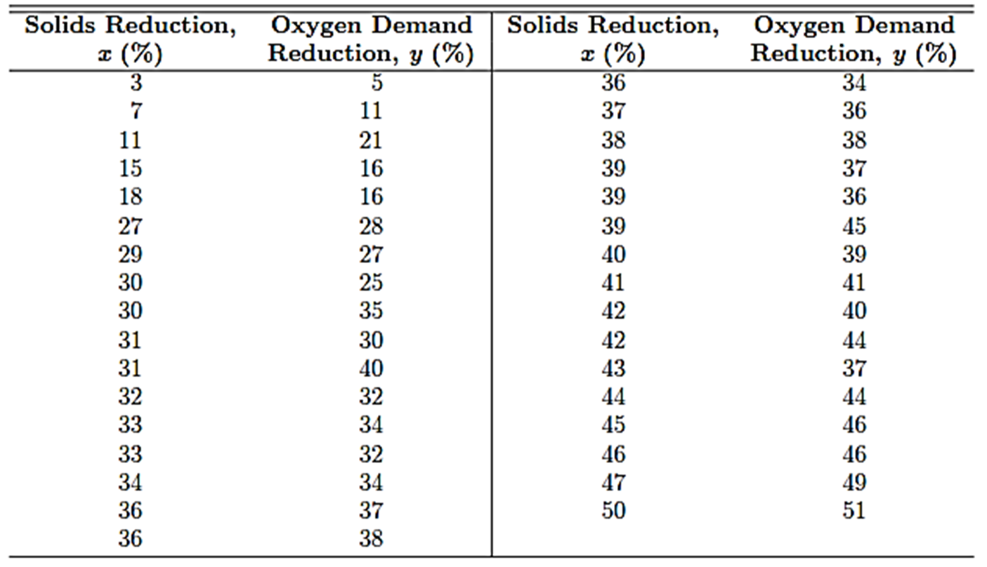

Slide 14
Ex 11.18- 11.21
Ex11.24

Slide 15
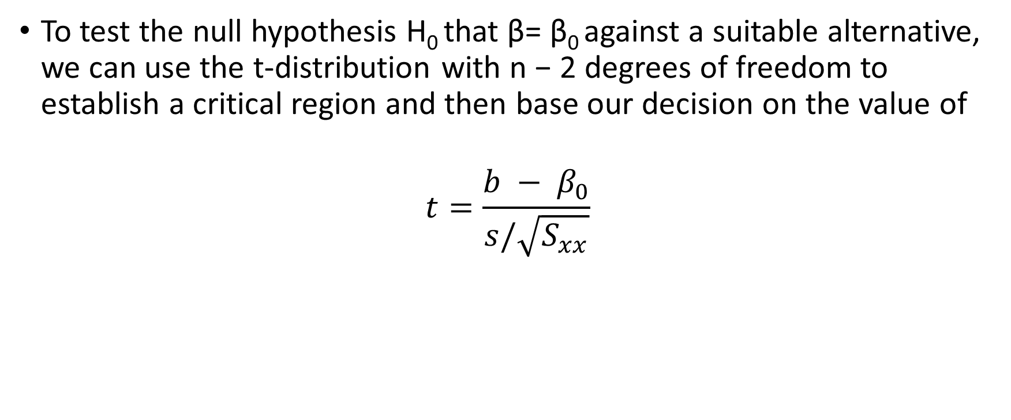
For Assignment only
To test the null hypothesis H₀ that β= β₀ against a suitable alternative, we can use the t-distribution with n − 2 degrees of freedom to establish a critical region and then base our decision on the value of
$$t=\frac{b − β_{0}}{s/\sqrt{S_{xx}}}$$

